Slide 1

ROBOKIDS
ACTIVITY 5 & 6

Slide 2
Robots around the world
Let’s have a look at a couple of examples of autonomous robots in action around the world.
(put on full screen when YouTube opens!)
http://www.youtube.com/watch?v=EzjkBwZtxp4
http://www.youtube.com/watch?v=rSKRgasUEko
http://www.youtube.com/watch?v=v-ALooMgQNU&feature=related

Slide 3
AIMS of Activity 5
Introduce autonomous mode
Work out how to get robot to go in curved and straight lines by adjusting the speed difference between the two wheels.

Slide 4
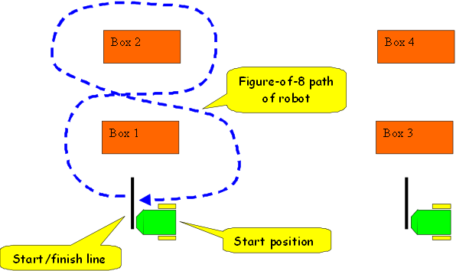
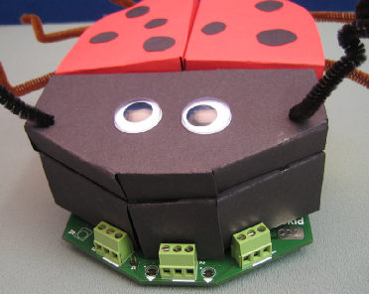
What does AUTONOMOUS mean?
This means that the robot will move independently.

Slide 5



Activity 5 Materials
Working robots (switch controller disconnected)
Activity 5 video
Black tape to mark out a straight line
Activity worksheet

Slide 6

Activity 5 Location
Straight line work will be done using the black tape on the table tops or on the floor in the classroom/area.
10-pin bowling practice will be done in the hall!

Slide 7
Activity 5 Background
This is the first activity where the robot is not directly controlled by the switch controller. The robot will be working in autonomous mode where the computer has to make decisions about what to do.
The aim of much of current robot development is to make useful autonomous robots. That is, robots that can be given a task, which they do without a human operator having to direct its every move.
An interesting example is the robot vacuum cleaner.

Slide 8
Important Information
The basis of this activity is that although components are manufactured to be identical, they are never exactly the same.
For example, the motors used in the robot are made in the same factory and on the same machines, but are slightly different.
The result is that when the two motors are given the same battery voltage, the two motors will run at slightly different speeds. The result is that the robot moves in a curve rather than in a straight line. This is a well known effect. The solution is to get the computer in the robot to make a slight adjustment to one of the motors to get both motor speeds to be as equal as possible.

Slide 9

Activity 5 Video
Let’s watch closely to see how it should be done.
http://www.youtube.com/watch?v=q0YKGWZdBmA&feature=player_embedded

Slide 10
Activity 5
Work in your groups to carry out activity 5. Please come to see me when you need the black tape and I will put it on the desk or the floor in the area for each person to practice.

Slide 11
AIMS of Activity 6
Use the knowledge gained in activity 5 to make the robot move in curved lines just like a bowling ball. You will have to relate the desired action of the robot to a position of a POT.

Slide 12
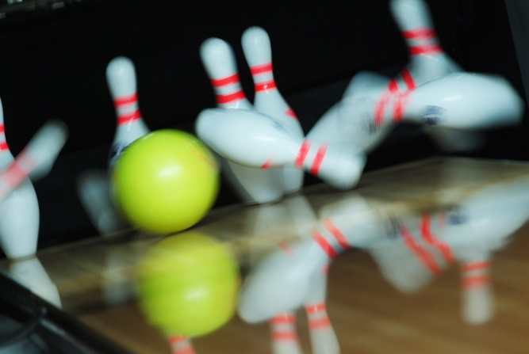
Activity 6 Materials
Working robots (switch controller disconnected)
Sets of skittles (e.g. empty water bottles)

Slide 13
Activity 6 Background
Robots don’t always move in straight lines.
In fact, moving in curves round obstacles can be quicker than moving in straight lines only, and can use less battery energy. This allows the robot to work for longer.
Curves can be created by moving the wheels at different speeds. These curves can vary from tight circles and spins to long slow arcs.

Slide 14
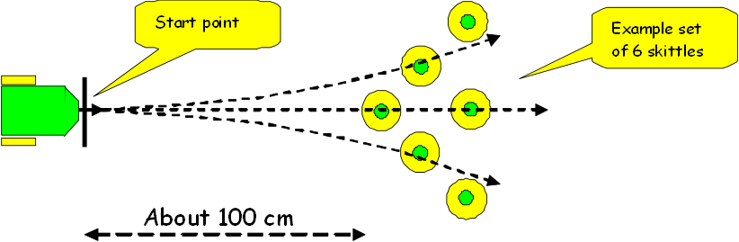
Activity 6 Set-up!

Slide 15
The robot MUST always start pointing straight ahead. This is to ensure that you adjust the POTs to get the robot to take a curved path.
The adjustments are
POT1 - speed of robot
POT2 - adjusts speed of one motor compared to the other (gives the curve effect)
POT3 - varies the time the robot runs for (between 2 and 8 seconds)
Use mode “A0” for this activity. Switch sequence is “A_D_2A”
To do a run do the following
Put robot into mode “A0”
Set the three POTs to the required setting
3. Press SW-B to instruct robot to read the POT settings
Press SW-A to do the move

Slide 16
Activity 6 Notes
Practice using the three POTs to set different curved paths. Take notes on the outcome of various settings.
We will complete the activity by having a competition with one skittle set-up for the whole class. Each team to get two tries to knock over as many skittles as possible.

